Slide 1


📊 Fake News Detector + Generative Justification
SUBMITTED BY :
HARSHITA KHOBRAGADE : 25030242022
HIMAN JYOTI DAS : 25030242023
J SREYAS :25030242025
Notes:
1

Slide 2



📰 Fake News Detector with Generative Justification
Detect Fake vs Real News and explain why the model made that decision
Classifier Builder
Prompt Engineer
Evaluator
Notes:
2

Slide 3


Motivation: The Need for Transparency
Fake news spreads rapidly, impacting society, politics, and the economy.
Existing classification systems lack transparency, leaving users unaware of why a decision was made.
Our solution not only detects fake vs. real news but also generates human-readable justifications.
Notes:
3

Slide 4

Dataset: Kaggle's Fake and Real News
Source: Fake and Real News Dataset (Kaggle).
Fake.csv: ~20k fake news articles.
True.csv: ~20k real news articles.
Preprocessing Steps:
Clean text (remove URLs, symbols).
Merge title + text into 'content'.
Fake News
Real News
Label: Fake = 1, Real = 0.
Train/Test split = 80/20.
Notes:
4

Slide 5






Workflow Overview: From Data to Justification
Classification (Logistic Regression)
Data Collection & Cleaning
Justification (FLAN-T5)
Feature Extraction (TF-IDF)
Explanation (Top Tokens)
Deployment (Streamlit)
Notes:
5

Slide 6
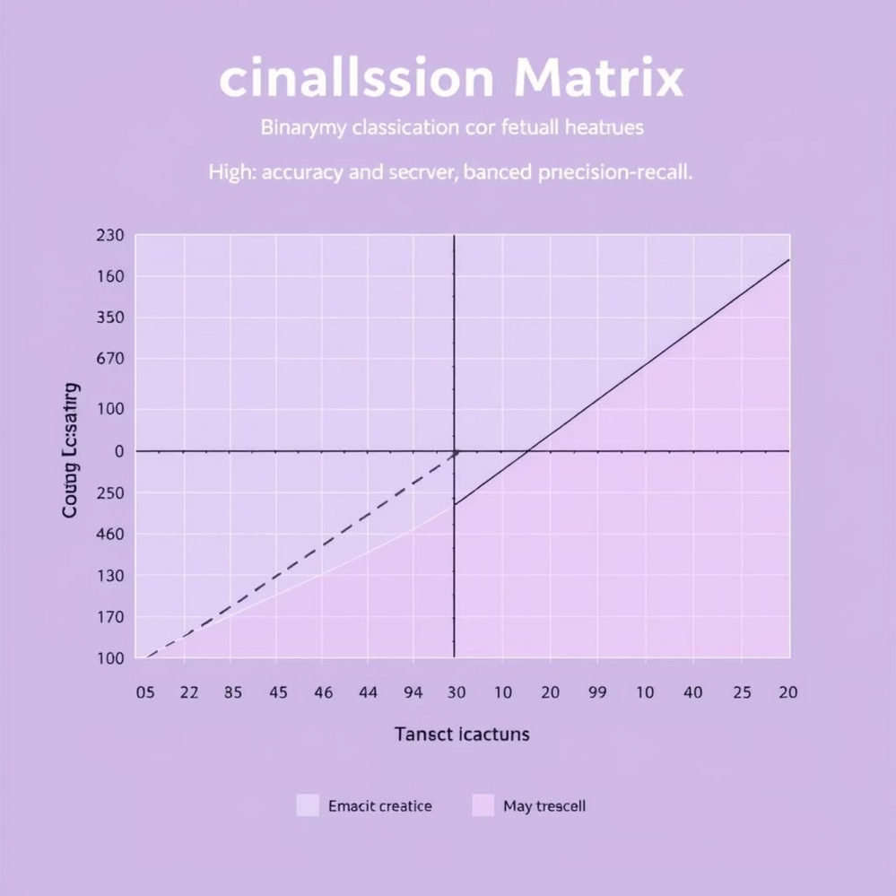
Classifier: TF-IDF + Logistic Regression
Model Choice:
Selected for its speed, interpretability, and strong baseline performance.
Training Details:
TF-IDF with 20,000 features.
Bi-grams included.
Logistic Regression (max_iter=1000).
Performance (Test Set):
Accuracy: ~94–95%
Precision/Recall: Balanced.
Notes:
6

Slide 7

Explanation: Model Transparency
Moving beyond black-box predictions, we extract top contributing tokens using Logistic Regression coefficients.
Example:
Prediction: Fake
Top features: rumor, hoax, breaking, etc
This method helps users and evaluators understand why a specific decision was made, fostering trust and insight.
Notes:
7

Slide 8
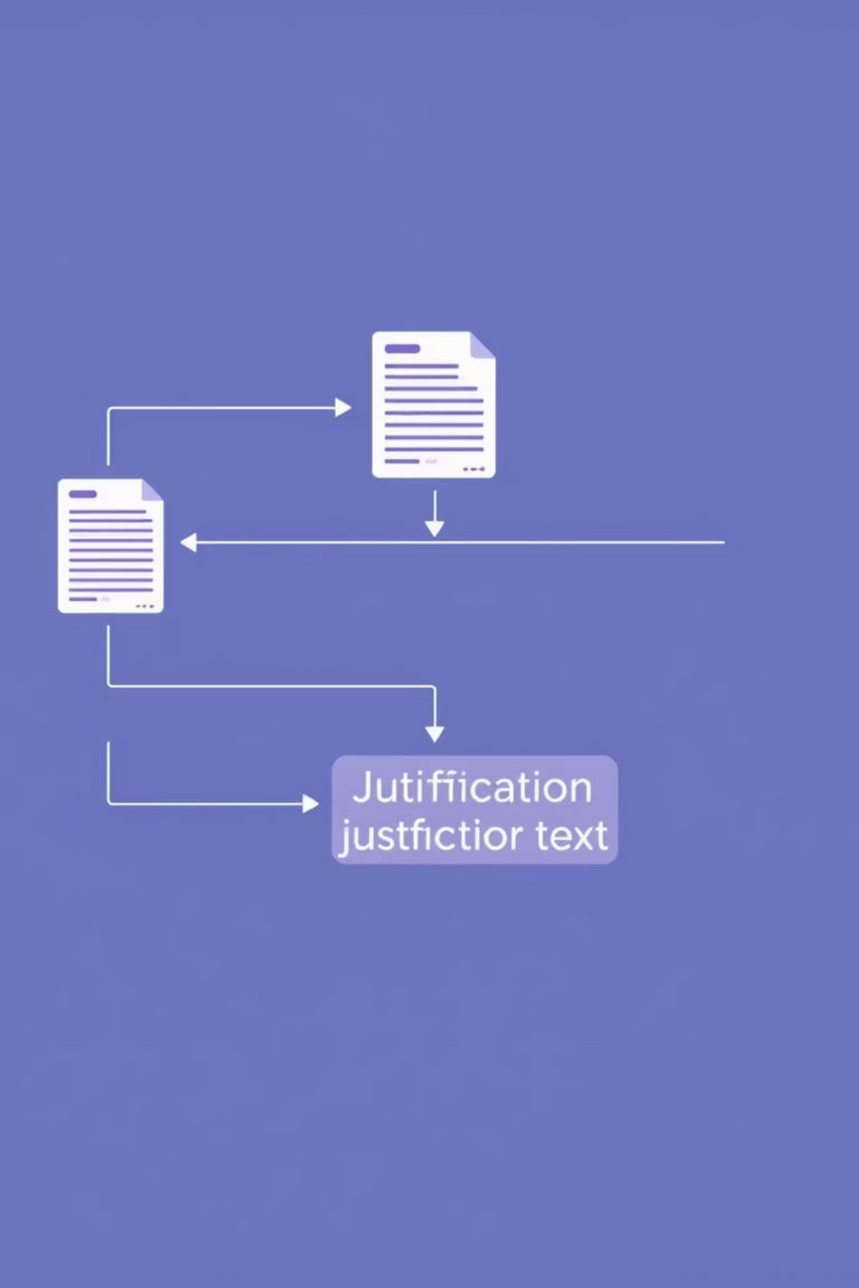
Generative Justification: FLAN-T5
Model: FLAN-T5 Small
Utilizes Google's FLAN-T5 (Hugging Face) for generating explanations.
Input Prompt
Includes article text, prediction, confidence score, and top contributing tokens.
Output: 2-3 Sentence Justification
Example: "The article was classified as Fake because it uses exaggerated language ('hoax', 'breaking') and lacks credible references."
Notes:
8

Slide 9

Streamlit App: Interactive Web Interface
Our simple, interactive web application allows users to paste an article and receive instant analysis.
Users Get:
Prediction (Fake/Real)
Confidence Score
Generated Justification
Top Features
Tech Stack:
Python, Scikit-learn, Hugging Face, Streamlit.
Notes:
9

Slide 10




Team Roles: Our Contributions
Classifier Builder
Prompt Engineer
Preprocessed dataset, built & trained Logistic Regression model.
Designed effective prompts for FLAN-T5 to generate justifications.
Evaluator
Tested system performance and validated the quality of generated justifications.
Notes:
10

